Slide 2
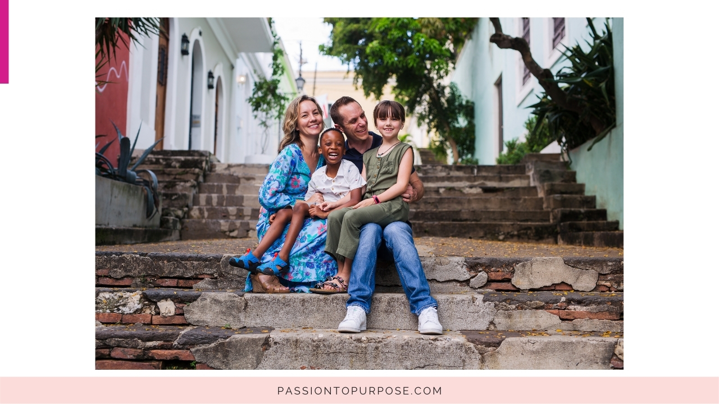
Notes:
I'm Amy a mom, wife, multi passionate entrepreneur.

Slide 3
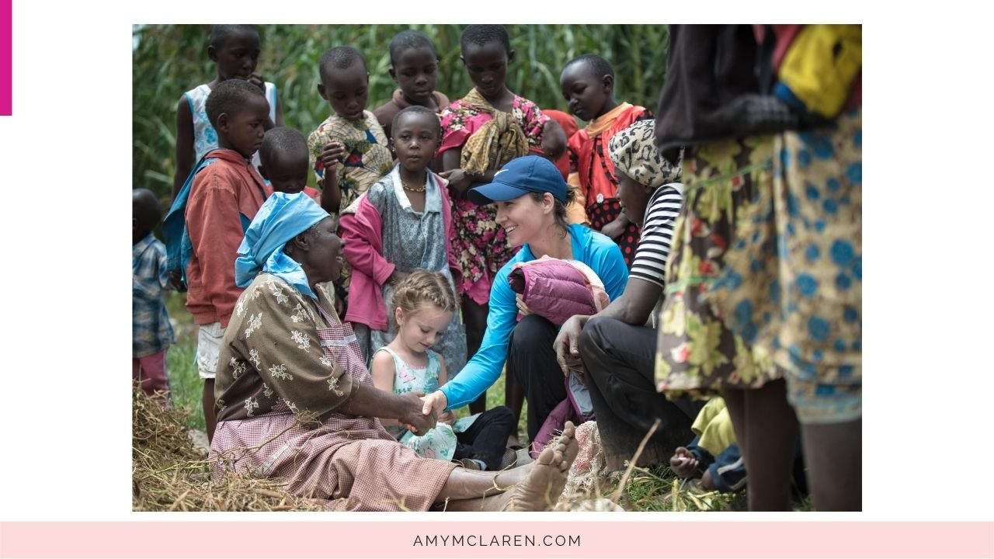
Notes:
I have a passion for giving back.
Co-Founder of Village Impact.

Slide 4
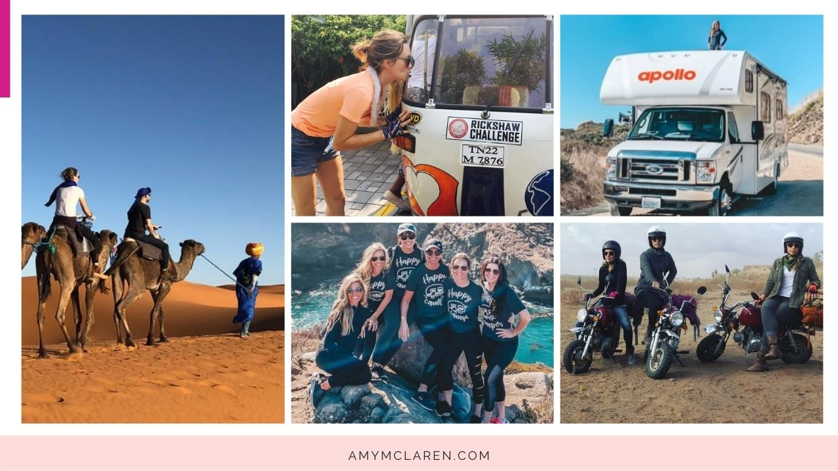
Notes:
2. LadyStrength - Lover of adventure travel and different experiences that get you out of your comfort zone

Slide 5
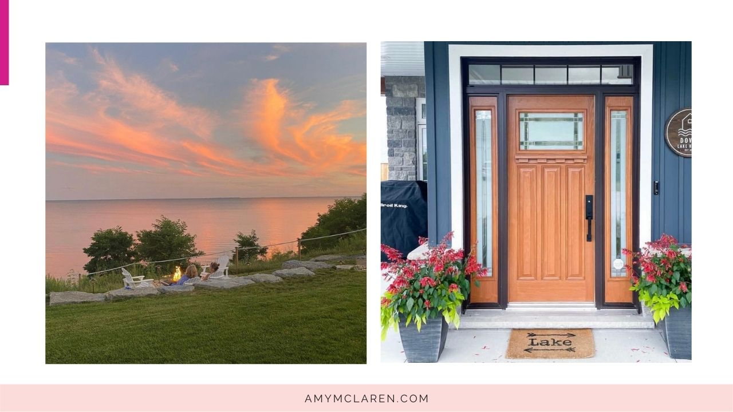
Notes:
3. Latest passion for creating experiences, creation of AirBnB

Slide 6
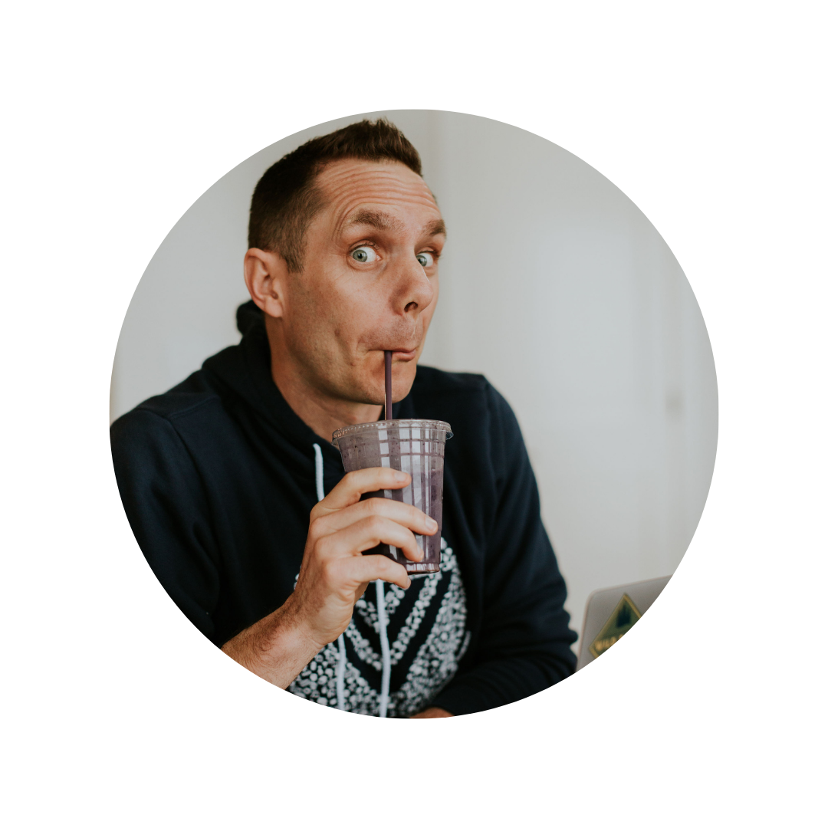
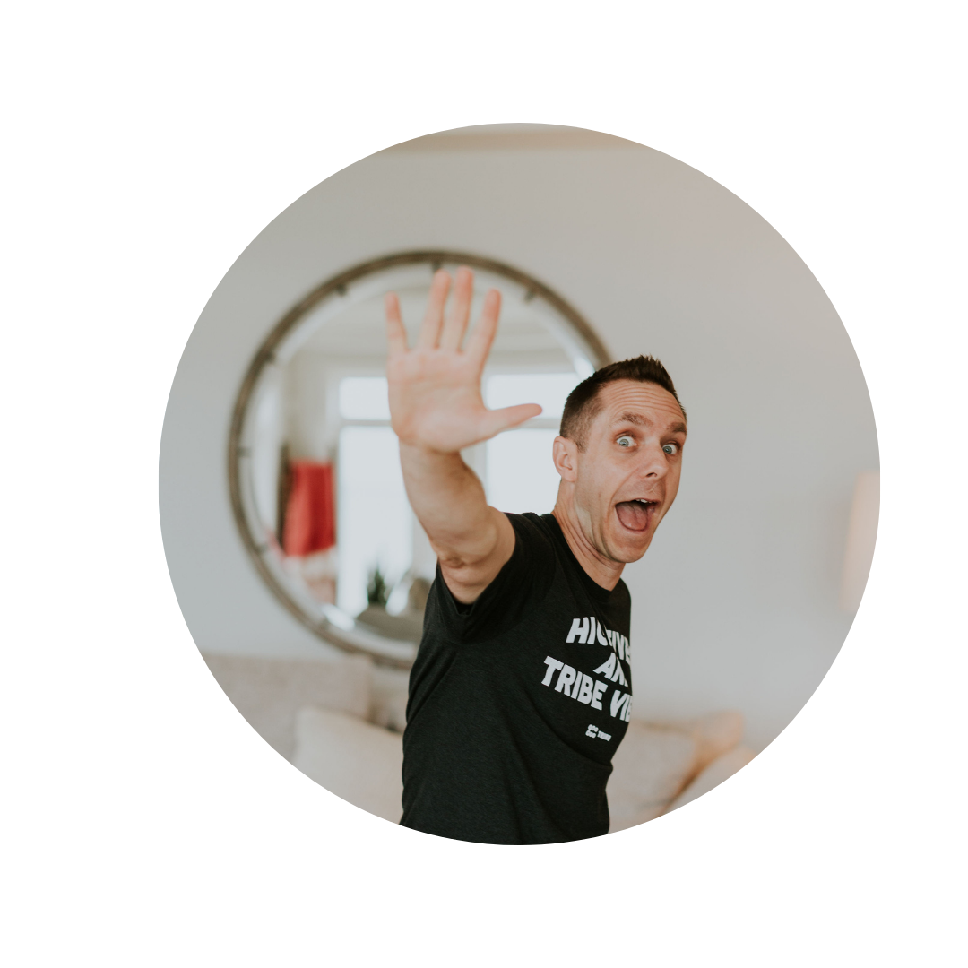
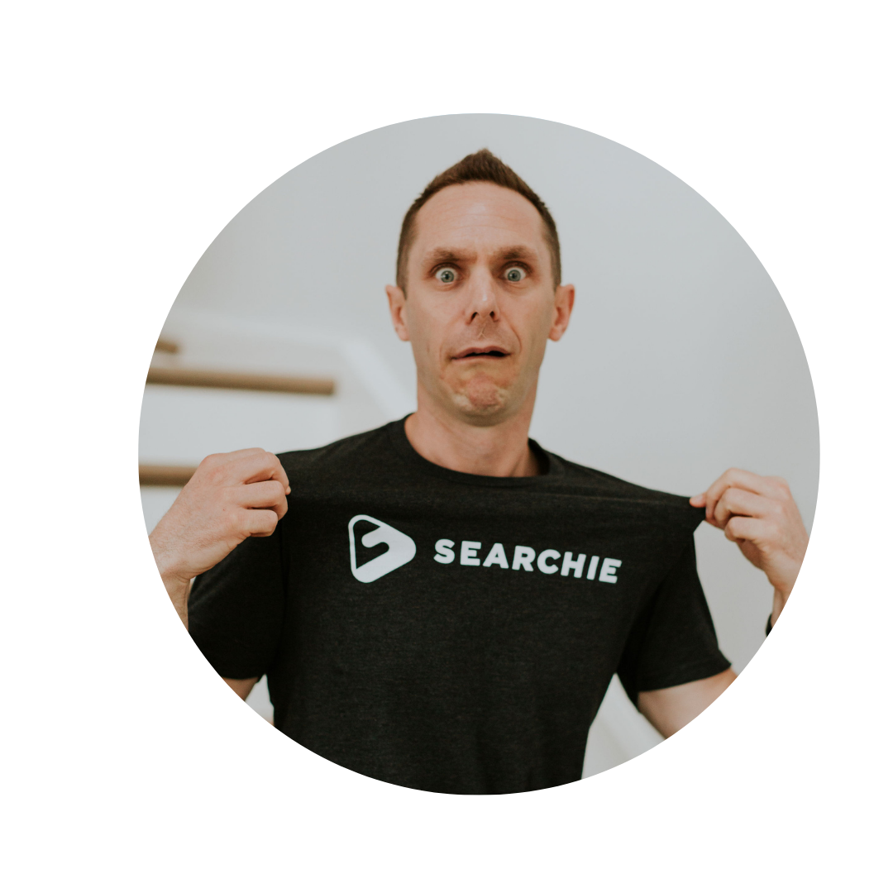
Notes:
And this is Stu.
Although we have differences, together we have created a life that I am really proud of.

Slide 7
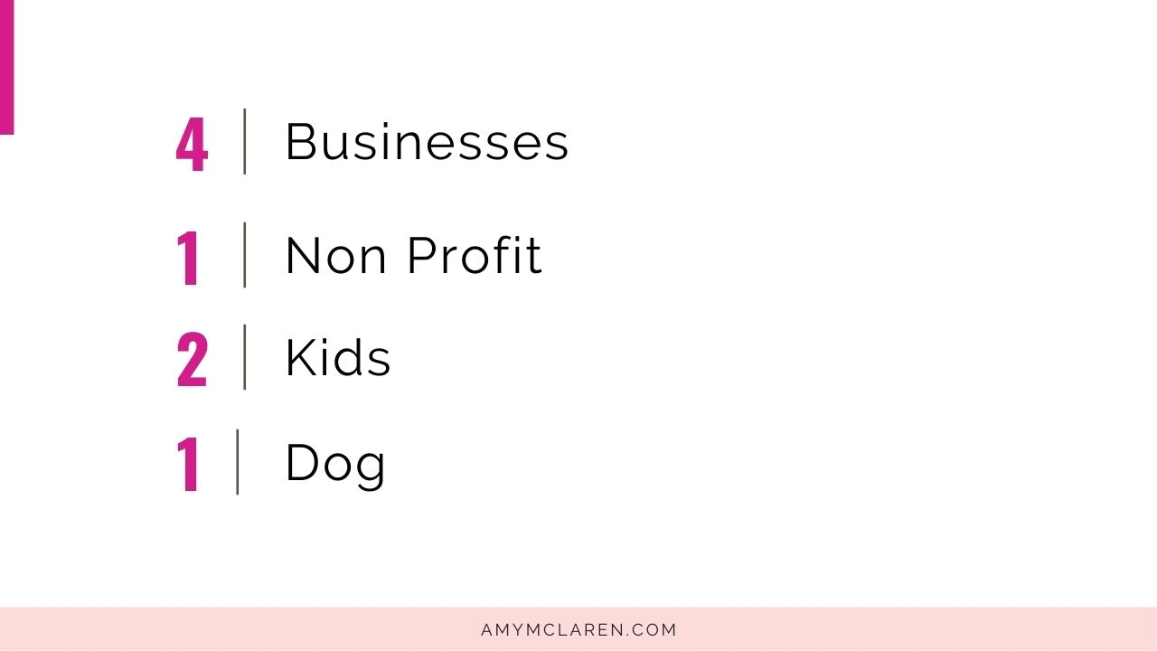
Notes:
Sounds exhausting right lol.
Let me share a few things that can help, that we learned the hard way..

Slide 8
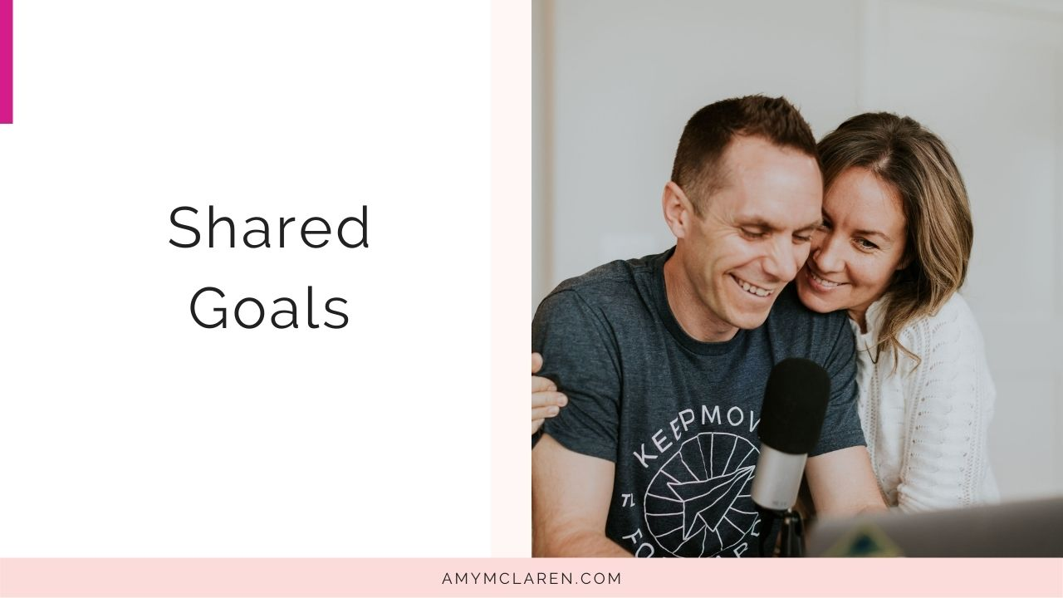
Notes:
Together, we have shared goals...

Slide 9
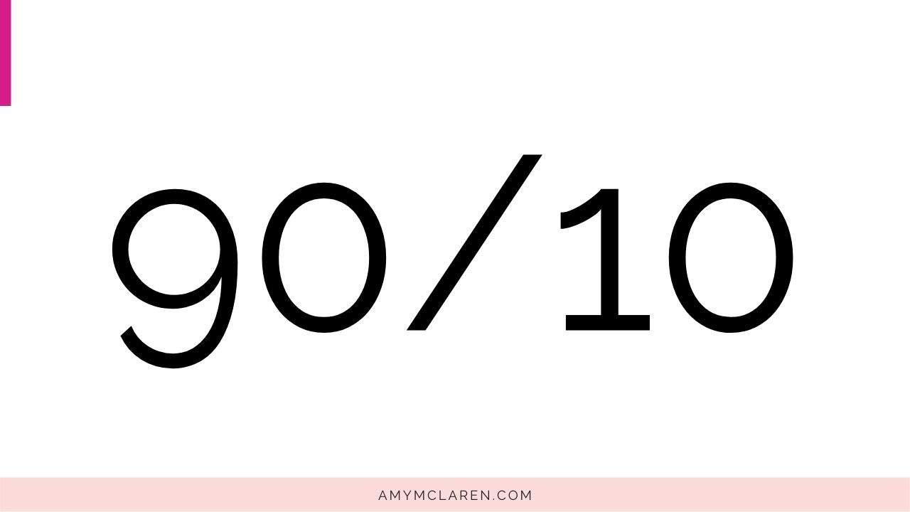
Notes:
The common mindset around giving is to live on90 percent and give 10 percent of it away to cases you are passionate about.

Slide 10
Notes:
But as entrepreneurs there are no limits. So what if you flipped this around nowhere you are living on ten percent and giving away 90 percent. This doesn't mean sacrificing your life style. But what it does mean is that you are thinking and striving in a much bigger way.
For example, to use easy math if your lifestyle costs 1M a year, that would mean your business would need to make $10.
2M - 20M
Stu and I are working towards this every year, and every year we get little closer.
That is the beauty about being an entrepreneur there is no ceiling.

Slide 11
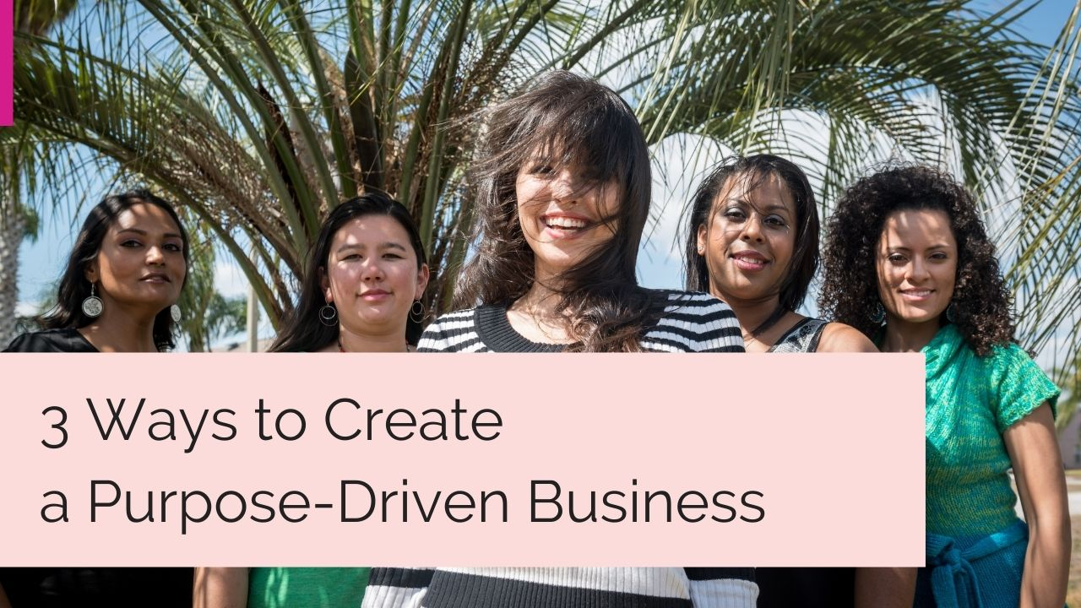

Slide 14
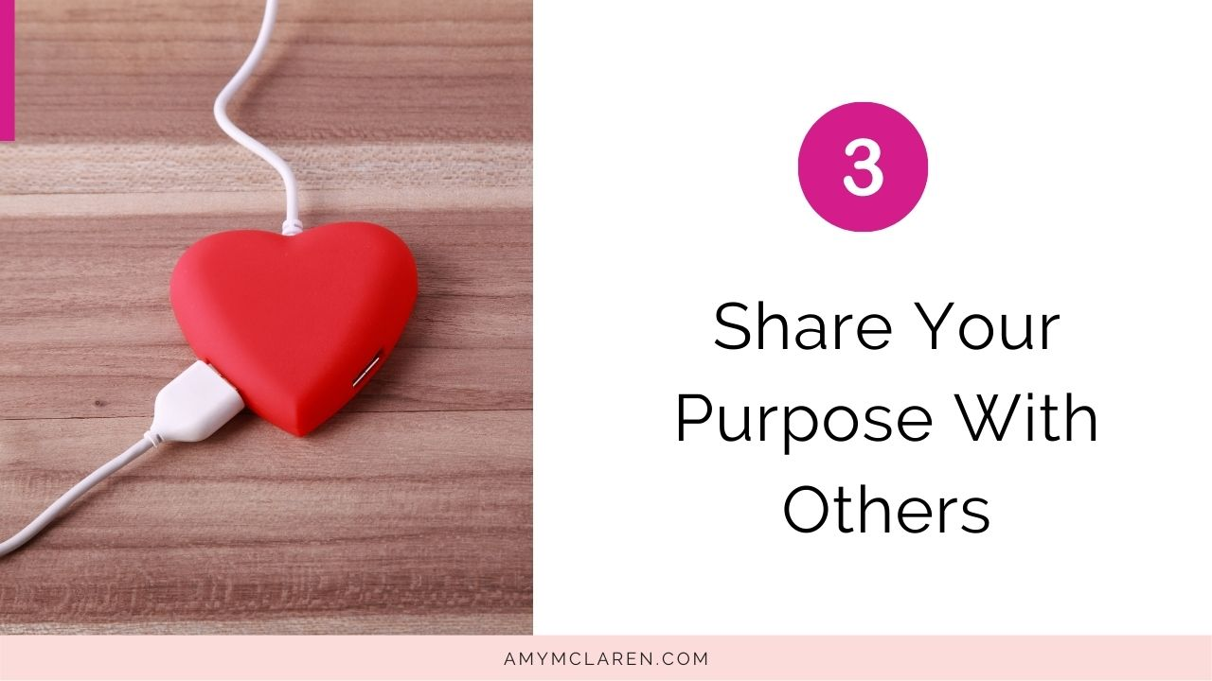

Slide 15
Notes:
Ladies this is great, but there is always someone who is trying to stop us—and it’s usually ourselves!

Slide 18
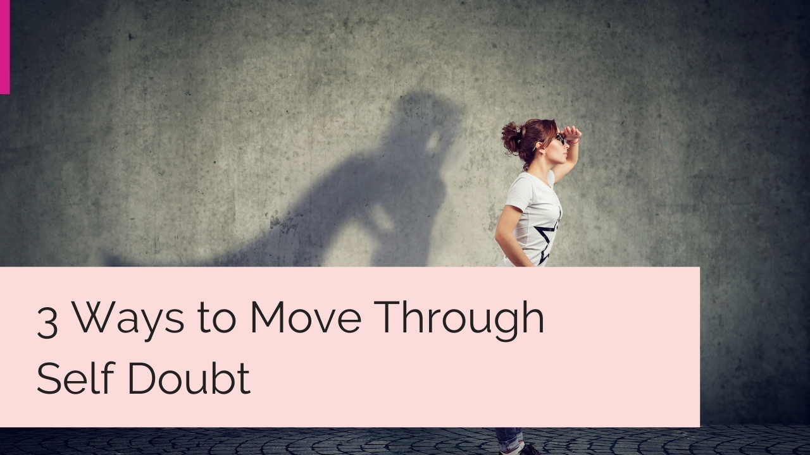

Slide 23
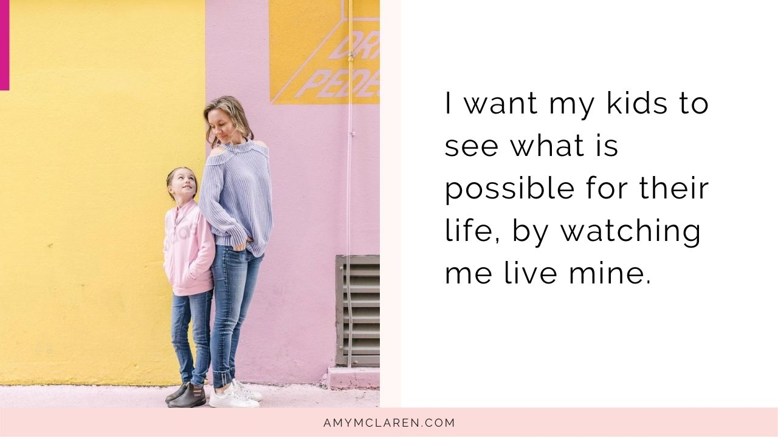

Slide 25
